Slide 1
Chapter 8
Group Processes

Slide 2
What Is a Group?
A group is a set of individuals who have direct interaction with each other over a period of time and share a common fate, identity, or set of goals.
Different from collectives:
  people engaging in a common activity but having little direct interaction with each other.

Slide 3
Groups
Groups can be quite different from the sum of their parts.
Why? Think of groups as being an average representation of members
  Individual differences!

Slide 4
Why Join a Group?
Humans have an innate need to belong to groups stemming from evolutionary pressures
  Physical protection
  Social identity theory
Notes:
Much of what we hope to produce and accomplish can be done only through collective action.

Slide 5
Key Features of Groups: Roles
Group socialization may be explicit or implicit in establishing role expectations
Fundamental types of roles:
  Instrumental: Role to help the group achieve its tasks
  Expressive: Provides emotional support and maintain morale
Groups function much better when members are assigned roles that best match their talents and personalities.

Slide 6
Key Features of Groups: Cohesiveness
The extent to which forces push group members closer together, such as through feelings of intimacy, unity, and commitment to group goals.
Group cohesion is associated with better performance, but other variables are important in predicting when and to what extent this relationship emerges.

Slide 7
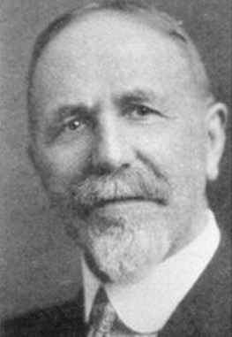
Social Facilitation
How does the presence of others affect behavior?
Norman Triplett’s (1897–1898) fishing reel studies:
  Children reeling in a flag. Faster alone or in competition?
  Increases nervous energy and enhances performance
Notes:
Triplett's Bicycle study (1898)
Later studies proved mixed results
The presence of others enhanced performance; at other times, performance declined.
Similar finding as the fishing reel study: Cyclists were faster when racing vs. when riding alone

Slide 8
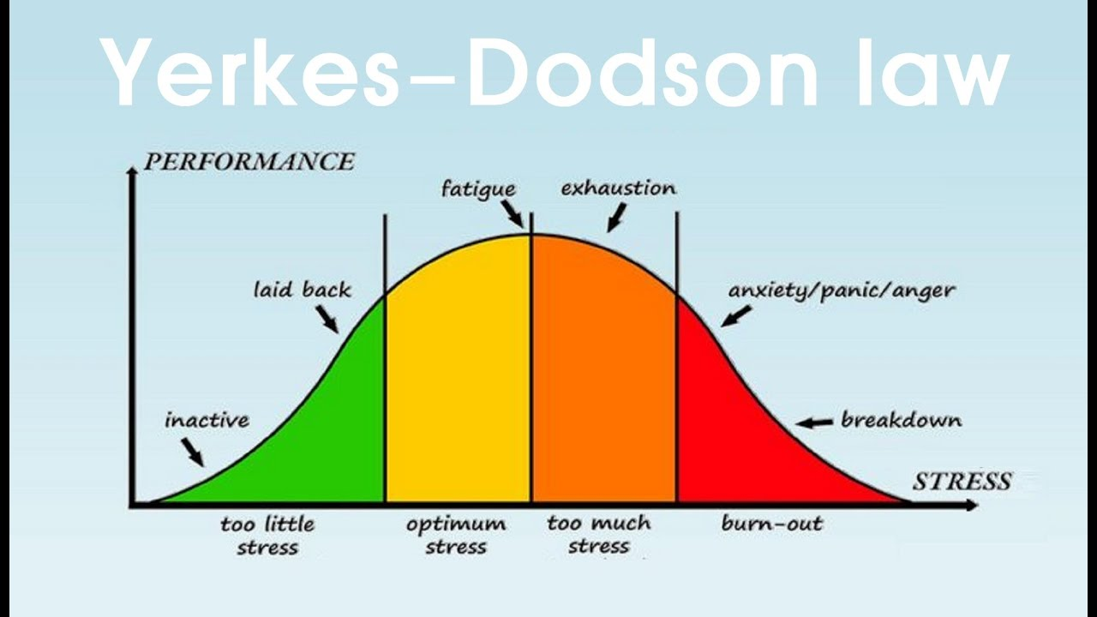
Yerkes-Dodson’s Law
Presence of others produces stress!
Notes:
Task difficulty effects this

Slide 9
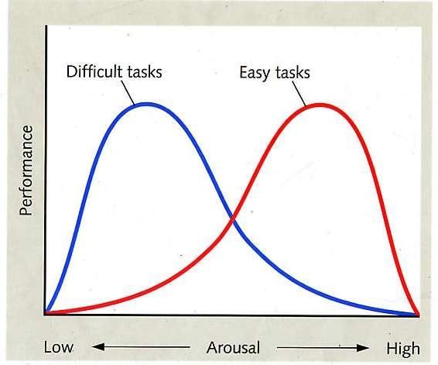
Social Facilitation: (McLeod et al. 2011)
Notes:
A process whereby the presence of others enhances performance on easy tasks but impairs performance on difficult tasks.

Slide 10
Group Performance
What about groups of individuals who are working together?
  Do groups outperform the sum of people working individually?
  When and how are groups most likely to perform well?

Slide 11
Losses and Gains in Groups
Process loss
  The reduction in group performance due to obstacles created by group processes, such as problems of coordination and motivation.
Process gain
  The increase in group performance so that the group outperforms the individuals who make up the group.

Slide 12
Social Loafing
Social loafing
  A group-produced reduction in individual output on easy tasks in which contributions are pooled.
  Specific performance of any one individual cannot be determined within the pooled effort.
Notes:
ocial loafing is when individuals exert less effort in a group setting than they would working alone, often assuming others will pick up the slack. A classic example is a group project where some members contribute less, expecting others to complete the work.

Slide 13
Social Loafing
Is this due to less individual effort or poor coordination of efforts?

Slide 14
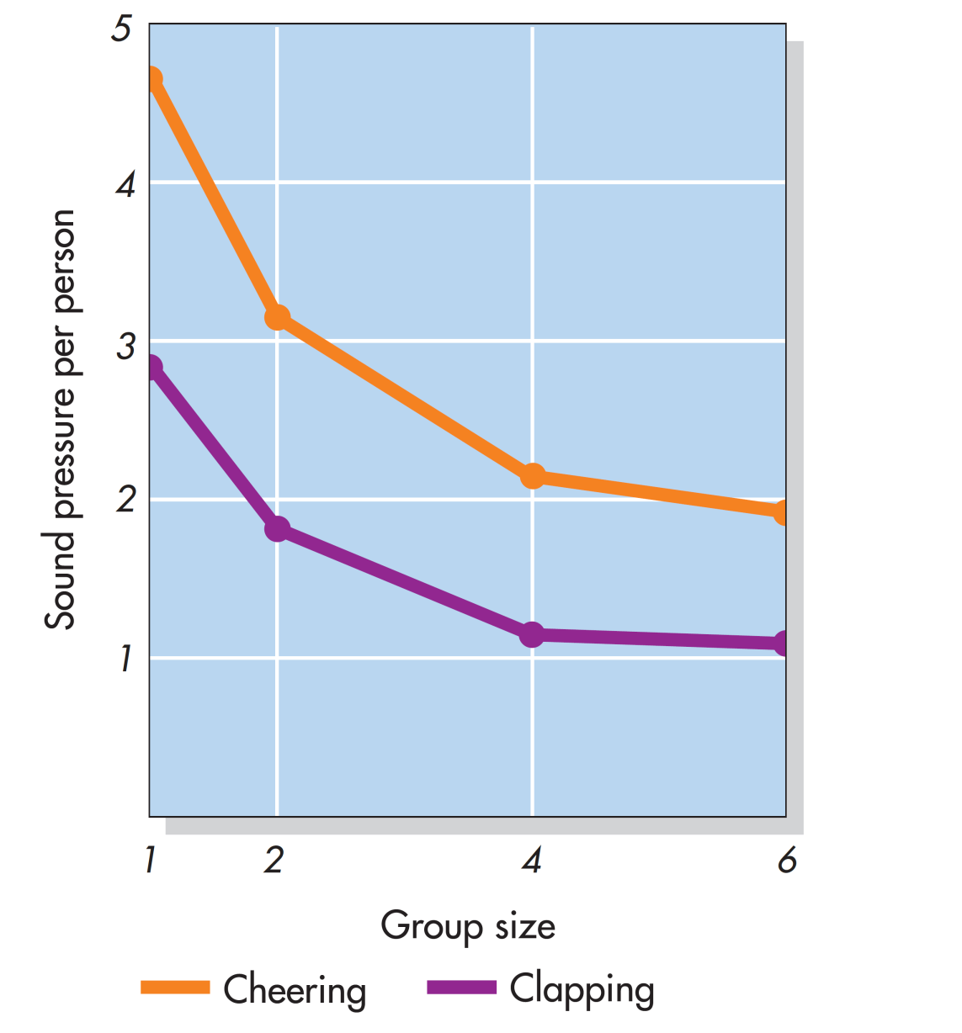
Social Loafing: When Many Produce Less (Latane et al., 1979)
Notes:
Figure 8.3 Social Loafing: When Many Produce Less Social loafing is a group-produced reduction in individual output on simple tasks. In this study, college students were told to cheer or clap as loudly as they could. The noise produced by each of them decreased as the size of the group increased. Based on Latané et al., 1979.

Slide 15
Collective Effort Model
Collective effort model
  The theory that individuals will exert effort on a collective task to the degree that they think their individual efforts will be important, relevant, and meaningful for achieving outcomes that they value.
  Social compensation
  Increasing their efforts on collective tasks to try to compensate for the anticipated social loafing or poor performance of other group members

Slide 16
Deindividuation
Deindividuation
  The loss of a person’s sense of individuality and the reduction of normal constraints against deviant behavior

Slide 17
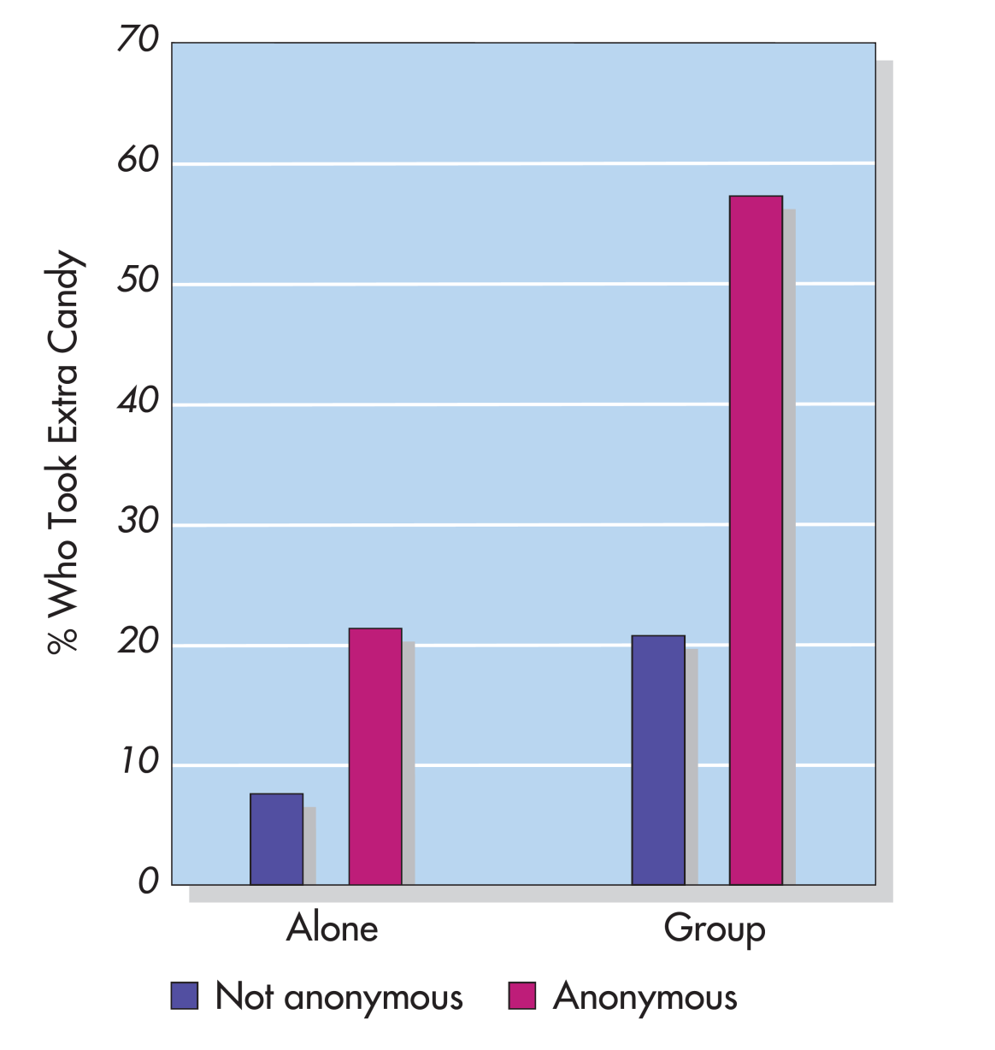
Diener et al. (1976) Candy Study
Notes:
Figure 8.4 Trick or Treat(s) Children trick-or-treating on Halloween were part of a field experiment. They were told to take one piece of candy before the experimenter, who greeted them, left them alone with the bowl of candy. Some were asked their name when greeted, others were not (anon vs not anon). The bars in this graph represent the percentage of children who took more than the one piece of candy. Consistent with predictions based on deindividuation, the children who were in a group (rather than alone) and were anonymous (rather than asked their names) were most likely to cheat by taking extra candy. Based on Diener et al., 1976.

Slide 18
Groupthink
A group decision-making style characterized by an excessive tendency among group members to seek concurrence.
Three characteristics contribute to the development of groupthink:
  Highly cohesive groups
  Group structure
  Stressful situations
Notes:
Why is this problematic?
What factors could lead to group think?

Slide 19
Preventing Groupthink
To avoid isolation, groups should consult widely with outsiders.
To reduce group pressures to conform, leaders should explicitly encourage criticism and not take a strong stand early in the discussion.
To establish a strong norm of critical review: Subgroups should separately discuss the same issue and question all decisions and ideas.

Slide 20
Communicating Information and Utilizing Expertise
Group performance often fails to use all of the information or skills that the group members have.
  Biased sampling: Tendency for groups to spend more time discussing shared information than unshared information
  Problem because group members are simply rehashing what is already known!
    No progress!

Slide 21
Goals and Plans in Groups
How fix?
To “do your best” is not as effective as establishing goals that are:
  Specific
  Challenging
  Reachable goals
Group members can hold each other accountable and encourage each other to keep trying to achieve a goal.

Slide 22
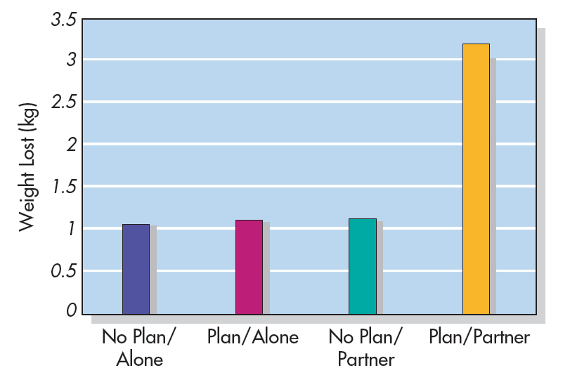
Sticking to a Plan: Exercise and Weight Loss (Prestwich et al., 2012)
(After 6 months)
Notes:
Figure 8.7 Sticking to a Plan: Exercise and Weight Loss Participants wanting to exercise more and lose weight worked either alone or with another person and were either instructed to set specific plans for how to achieve their goal (including how they would respond in particular situations) or were not instructed to do so. Six months later, the participants who both set a specific plan and worked with a partner lost significantly more weight than did the participants in any of the other conditions. Based on Prestwich et al., 2012.

Slide 23
Collective Intelligence: Are Some Groups Smarter Than Others?
  What predicts which groups have strong collective intelligence?
  Important factors:
  Having group members who tend to be strong in social perceptiveness
  Allowing the various group members to take turns participating in the discussion
  Having a higher proportion of women

Slide 24
Conflict
What kinds of dilemmas do groups often confront?
What factors influence whether individuals and groups act cooperatively or competitively in dealing with them?

Slide 25
Mixed Motives and Social Dilemmas
Social dilemma
  A situation in which a self-interested choice by everyone will create the worst outcome for everyone.
  Pursuit of self-interest can sometimes be self-destructive

Slide 26
The Prisoner’s Dilemma (1 of 2)
A type of dilemma in which one party must make either cooperative or competitive moves in relation to another party.
  Designed so the competitive move appears to be in one’s self- interest, but if both sides make this move, they both suffer more than if they had both cooperated.
  No communication between parties!

Slide 27
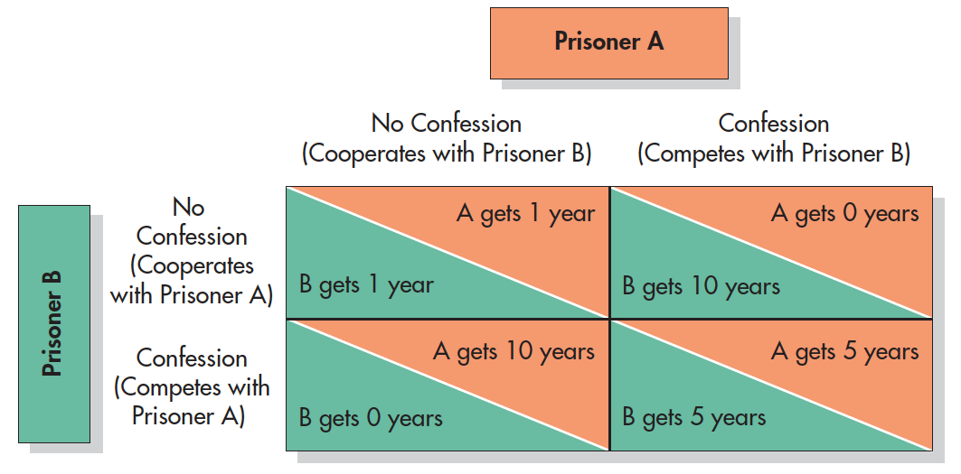
The Prisoner’s Dilemma (2 of 2)
Notes:
Figure 8.9 The Prisoner’s Dilemma Each of two criminals is offered immunity from prosecution in exchange for a confession. If both stay silent, both get off with a light sentence on a minor charge (upper left). If both confess, both receive a moderate sentence (lower right). But if one confesses while the other stays mum, the confessing criminal goes free, and the silent one spends a long time in prison.

Slide 28
Resource Dilemmas
Resource dilemmas
  Social dilemmas involving how two or more people will share a limited resource.
Two basic types
  Commons dilemma: If people take as much as they want of a limited resource that does not replenish itself, nothing will be left for anyone.
  Public goods dilemma: All of the individuals are supposed to contribute resources to a common pool.

Slide 29
Responding to Social Dilemmas: Groups and Individuals
The fear of being exploited and the greedy desire are critically important factors in determining reactions to social dilemmas
What factors promote cooperation?

Slide 30
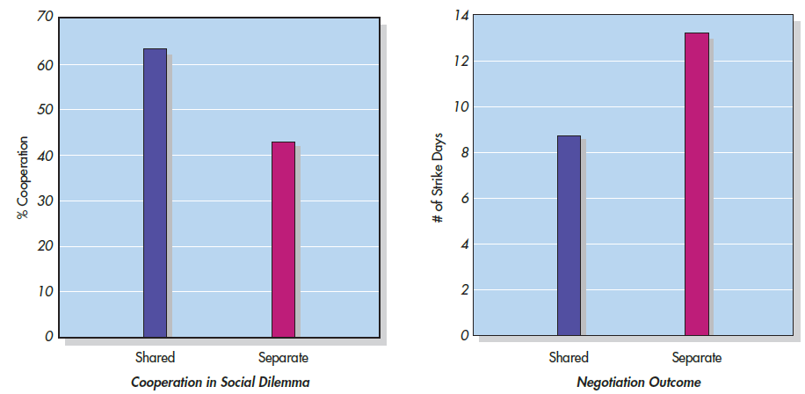
Woolley & Fishbach (2019)
Notes:
Figure 8.10 Sharing Is Caring The graph on the left illustrates that pairs of strangers were more likely to cooperate with each other in solving a social dilemma if they had just shared crackers from the same bag than if they had eaten crackers from their own separate bags. The graph on the right illustrates a similar finding for negotiations: Pairs tended to negotiate settlement more quickly (lower numbers indicate faster settlements) if they had eaten chips and salsa from a shared bowl than from their own bowls. Based on Woolley and Fishbach, 2019.

